Slide 1
Processes and Threads

Slide 2
Process in android :heavy weight
When an application started newly, the Android system starts a new dedicated OS process for the application. That default process has single thread for execution called main thread. Whole application is managed by that main thread and process.

Slide 3
Once some process assigned to any component of an application , same process will get assigned to other components of an application.
To run different components of your application ,we can create separate processes, and you can create additional threads for any process.

Slide 4
To assign different process to other components of application
This can be done in manifest file.
The manifest entry for each type of component element—<activity>, <service>, <receiver>, and <provider>—supports an android:process attribute that can specify a process in which that component should run
You can also set android:process so that components of different applications run in the same process.
The <application> element also supports an android:process attribute, to set a default value that applies to all components.

Slide 5
Shut down of process
Android might decide to shut down a process at some point, when memory is low and required by other processes that are more immediately serving the user. Application components running in the process that's killed are consequently destroyed. A process is started again for those components when there's again work for them to do.
it more readily shuts down a process hosting activities that are no longer visible on screen, compared to a process hosting visible activities. The decision whether to terminate a process, therefore, depends on the state of the components running in that process.

Slide 6
Threads
Thread is soemthing in which your application interacts with components from the Android UI toolkit (components from the android.widget and android.view packages)
The system does not create a separate thread for each instance of a component. All components that run in the same process are instantiated in the UI thread, and system calls to each component are dispatched from that thread

Slide 7
When you interact with applications component very frequently the single main thread model can yield poor performance.
Specifically ,performing long operations such as network access or database queries will block the whole UI. When the thread is blocked, no events can be dispatched with a dialog app not reponding
the Android UI toolkit is not thread-safe. So, you must not manipulate your UI from a worker thread—you must do all manipulation to your user interface from the UI thread. Thus, there are simply two rules to Android's single thread model:
  Do not block the UI thread
  Do not access the Android UI toolkit from outside the UI thread

Slide 8
If you have operations to perform that are not instantaneous, you should make sure to do them in separate threads ("background" or "worker" threads).
Making different thread to run different components of application simultaneously is called multithreading

Slide 9
Advantages of Java Multithreading
1) because threads are independent and you can perform multiple operations at same time.
2) You can perform many operations together so it saves time.
3) Threads are independent so it doesn't affect other threads if exception occur in a single thread.

Slide 10
Life Cycle
The life cycle of the thread in java is controlled by JVM. The java thread states are as follows:
New
Runnable(Ready)
Running
Non-Runnable (Blocked)(Waiting)
Terminated

Slide 11
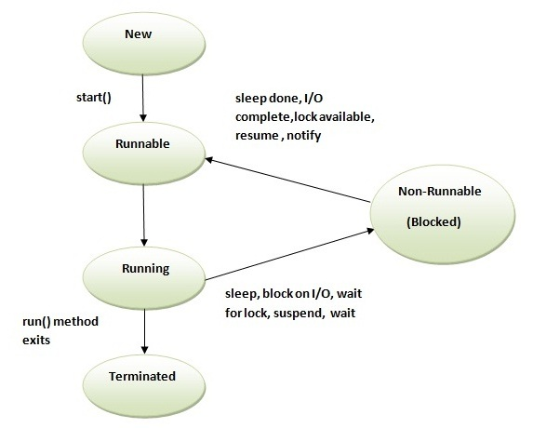

Slide 12
How to create thread
There are two ways to create a thread:
By extending Thread class
By implementing Runnable interface.
Thread class:
Thread class provide constructors and methods to create and perform operations on a thread. Thread class extends Object class and implements Runnable interface.

Slide 13
Commonly used methods of Thread class:
public void run(): is used to perform action for a thread.
public void start(): starts the execution of the thread.JVM calls the run() method on the thread.
public void sleep(long miliseconds): Causes the currently executing thread to sleep (temporarily cease execution) for the specified number of milliseconds.
public int getPriority(): returns the priority of the thread.
public int setPriority(int priority): changes the priority of the thread.
public String getName(): returns the name of the thread.
public void setName(String name): changes the name of the thread.

Slide 14
Runnable interface:
The Runnable interface should be implemented by any class whose instances are intended to be executed by a thread. Runnable interface have only one method named run().
public void run(): is used to perform action for a thread.

Slide 15
Starting a thread:
start() method of Thread class is used to start a newly created thread. It performs following tasks:
A new thread starts(with new callstack).
The thread moves from New state to the Runnable state.
When the thread gets a chance to execute, its target run() method will run.

Slide 16
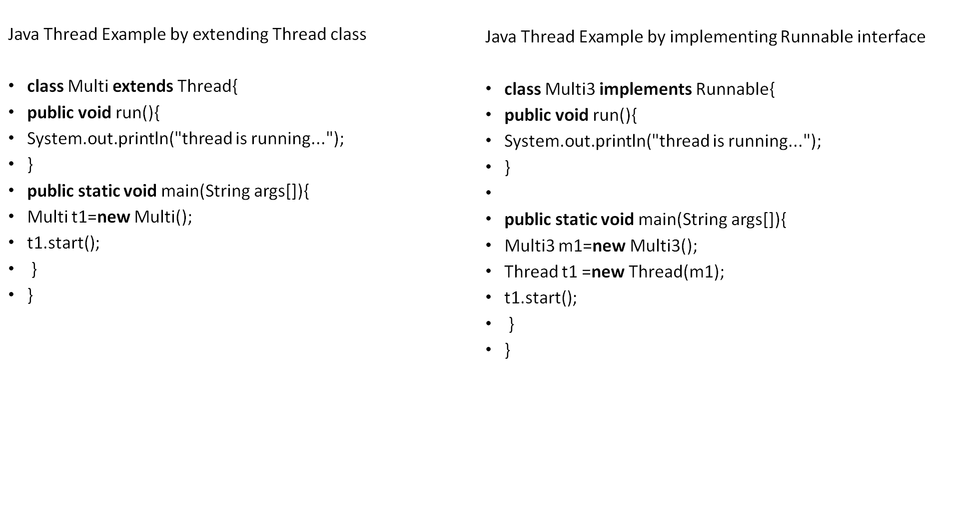
Notes:
If you are not extending the Thread class, your class object would not be treated as a thread object.So you need to explicitely create Thread class object. We are passing the object of your class that implements Runnable so that your class run() method may execute.

Slide 17
Thread scheduler
Thread scheduler in java is the part of the JVM that decides which thread should run.
There is no guarantee that which runnable thread will be chosen to run by the thread scheduler.
Only one thread at a time can run in a single process.
The thread scheduler mainly uses preemptive or time slicing scheduling to schedule the threads.

Slide 18
Handler
Handler is part of the Android system's framework for managing threads. A Handler object receives messages and runs code to handle the messages. Normally, you create a Handler for a new thread, but you can also create a Handler that's connected to an existing thread. When you connect a Handler to your UI thread, the code that handles messages runs on the UI thread.

Slide 19
Tasks and BackStack
A task is a collection of activities that users interact with when performing a certain job. The activities are arranged in a stack (the "back stack"), in the order in which each activity is opened.
A task is a cohesive unit that can move to the "background" when users begin a new task or go to the Home screen, via the Home button.

Slide 21
When used click any component on application launcher, that application's task comes to the foreground. If no task exists for the, then a new task is created and the launcher activity for that application goes as the root activity in the stack.
When the current activity starts another, the new activity is pushed on the top of the stack and takes focus. The previous activity remains in the stack, but is stopped.

Slide 22
When an activity stops, the system retains the current state of its user interface. When the user presses the Back button, the current activity is popped from the top of the stack) and the previous activity resumes .Activities in the stack are never rearranged, only pushed and popped from the stack—pushed onto the stack when started by the current activity and popped off when the user leaves it using the Back button.

Slide 23
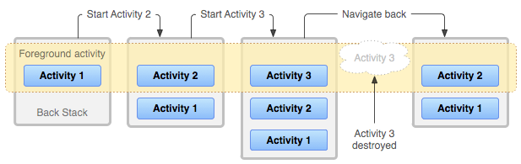

Slide 24
Because the activities in the back stack are never rearranged, if your application allows users to start a particular activity from more than one activity, a new instance of that activity is created and pushed onto the stack (rather than bringing any previous instance of the activity to the top).
if the user navigates backward using the Back button, each instance of the activity is revealed in the order they were opened (each with their own UI state).

Slide 25
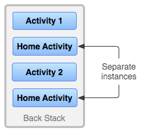
Backstack of tasks

